Slide 1
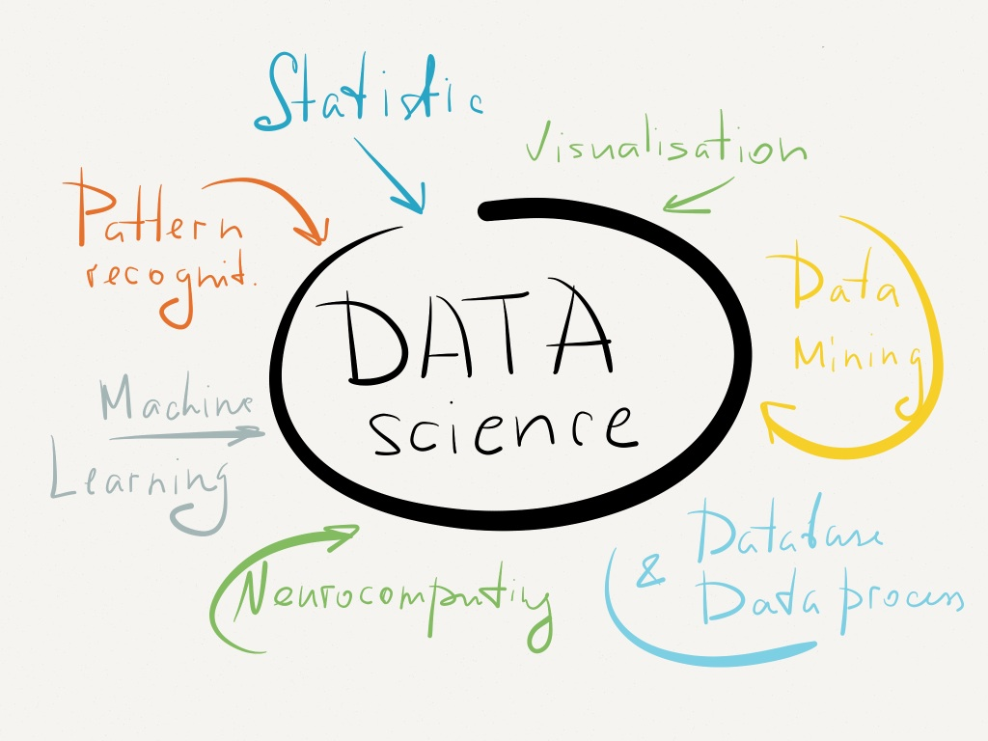
Data Jobs in America
Thomas Plapinger

Slide 2
Goals
Find the National Median Wage in Data Science Jobs
Find contributing factors to earning above the National Average
Location
Job Title
How Can Attract the Best Data Scientists?

Slide 3

Methods
Web Scrape across 30+ US cities for Data Science related Job Postings on Indeed.com
Focus on Attributes
Title
Company
Location
Job Description
Salary
Created Random Forrest and Logistic Regression Data Models to determine contributing factors

Slide 4
Results
Collected 7,680 job Postings across 39 US Cities
441(5.7%) Contained Salary listings
National Data Science Median Wage: $73, 680
Locations with Strongest Relationship to Above Average Wages
Seattle, Portland, San Francisco, New York, and Washington, DC
Job Title Terms that force Higher Wages
Software, Statistical, Machine Learning, and Research

Slide 5
Limitations of Search
Single Job Posting Website
Timeframe (Late July)
Lack Salary Data

Slide 6
Recommendation
To Attract the Best Data Scientist
Offer Competitive Salaries well above National Median
Focus on Building Profile in New York, San Francisco, and Washington, DC
Focus on Professionals with previous Job Titles involving Research, Machine Learning, and Statistical software.
Additional Focus on recruitment of Data Scientists from Data Industry sparse towns

Slide 7

Questions?

